Slide 1

Rockbuster Stealth LLC
Data Analysis
Online Video Launch Strategy
Simone van der Graaf
January 2024

Slide 2

In order to launch the company strategy for the online video rental service, the following key questions need to be answered:
● Which movies contributed the most/least to revenue gain?
● Which countries are Rockbuster customers based in?
● Do sales figures vary between geographic regions?
● What was the average rental duration for all videos?
● Where are customers with a high lifetime value based?
Rockbuster Stealth LLC

Slide 3
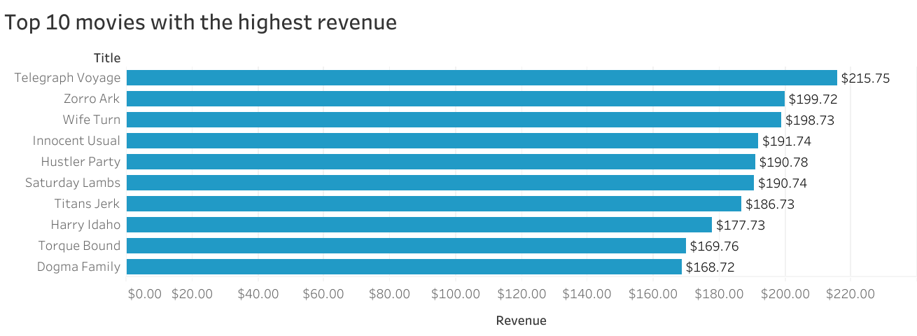
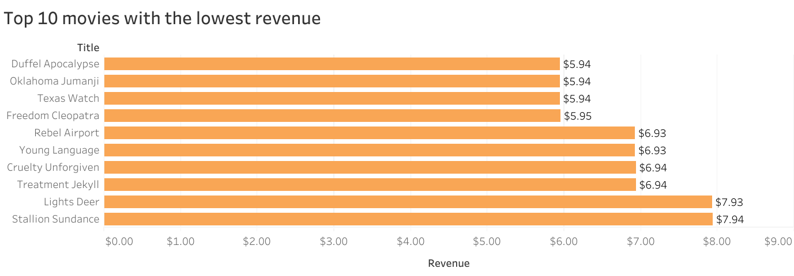
Which movies contributed the most/least to revenue gain?
Rockbuster Stealth LLC
Rockbuster Top 10 highest and lowest movie revenues | Tableau Public

Slide 4
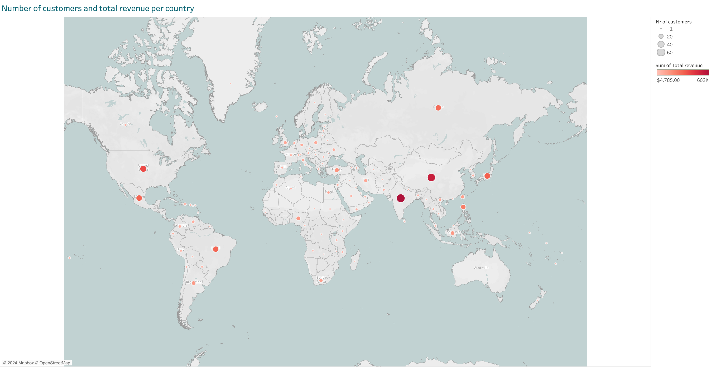
Which countries are Rockbuster customers based in? - Do sales figures vary between geographic regions?
Rockbuster Stealth LLC
Rockbuster nr of customers and total revenue per country | Tableau Public

Slide 5
What was the average rental duration for all videos?
​ | Rental Duration | Rental Rate
Minimum​ | 3​ | 0.99​
Maximum | 7​ | 4.99​
Average | 4.99​ | 2.98
Count​ | 1000 | 1000
Rockbuster Stealth LLC

Slide 6
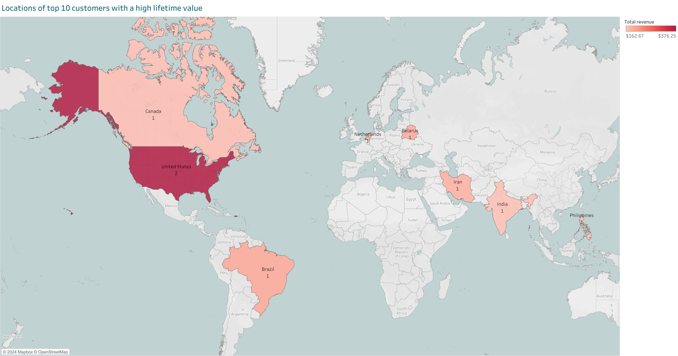
Where are customers with a high lifetime value based?
Rockbuster Stealth LLC
Rockbuster customers high lifetime value | Tableau Public

Slide 7
Conclusions and recommendations
The customers of Rockbuster are spread over the world with a large difference in revenue and customers for each country. India has with 60 the highest nr of customers.
For the launch of the online video rental service I would focus on the top 6 best performing countries: India, China, United States, Japan, Mexico and Brazil.
In 3 of those countries are 4 of the top 10 high lifetime value customers based.
Loyal customers with a total revenue from a minimum of $150,- could be offered an interesting discount to start their online video journey, that increases when they introduce new customers to Rockbuster.
The average rental duration if 4.99 days. For the first 3 months after the launch I would offer a special discount or a free coupon if someone rents an online video for a minimum of 5 days.
Rockbuster should implement AI in order to measure and analyse online behaviour from (potential) customers. This can be used to optimize the offer in movies but also to analyse the results of the first 3 months and slowly expand to other countries.
Rockbuster Stealth LLC

Slide 8

Questions?
Simone van der Graaf
s.vandergraaf@yahoo.com
Rockbuster Stealth LLC

